Slide 1
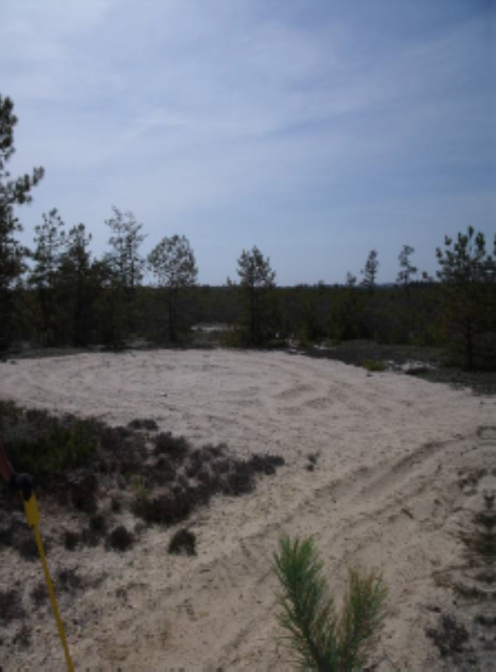
Suffolk County Army Airfield
BOMBING AND GUNNERY RANGE
FORMERLY USED DEFENSE SITE
Remedial Investigation through Record of Decision
Community Information Session
Julie Rupp
Project Manager
New England District
Geo-Environmental Engineering
Date: March 25 & 28, 2024

Slide 2
agenda
Introduction (acronyms, key definitions, Team)
Formerly Used Defense Sites (FUDS) Brief Program Overview
Site History: Suffolk County Army Air Field (AAF) Bombing and Gunnery Range (BGR) Munitions Response Site (MRS) Remedial Investigation Overview
What Does This Mean for Me?
Where to Find Information on the Project
In-Person Office Hours and Meeting
Estimated Schedule: What’s Next?
Safety Reminder and Questions

Slide 3
Acronyms
AAF Army Airfield
BGR Bombing and Gunnery Range
CERCLA Comprehensive Environmental Response, Compensation, and Liability Act
DoD Department of Defense
FUDS Formerly Used Defense Site
HE High Explosive
MC Munitions Constituents
MEC Munitions and Explosives of Concern
MRS Munitions Response Site
RI Remedial Investigation
ROE Right of Entry
USACE U.S. Army Corps of Engineers
UXO Unexploded Ordnance

Slide 4
Key Definitions
WHAT ARE WE LOOKING FOR?
Munitions and Explosives of Concern (MEC) -Military munitions that may pose explosives safety risks
Munitions Constituents (MC) – Degradation or breakdown elements of unexploded ordnance (UXO) or munitions (i.e., chemicals such as metals and explosives)

Slide 5
PROJECT TEAM
USACE
  Project Manager – Julie Rupp
  Technical Manager – Todd Beckwith
Contractor – Tetra Tech
    Tetra Tech Project Manager – Jennifer Harlan
    Tetra Tech Deputy Project Manager – Jeny Mitchell
    Supported by a team including Ordnance and Explosives Safety Specialists; Risk Assessors; Geophysicists; Chemists; Geologists; Public Affairs staff; Biologists; Cultural Resources Specialists; Real Estate Specialists

Slide 6
Formerly Used Defense Sites (FUDS)
Definition: Real property that was formerly owned by, leased to, or otherwise possessed by the United States and under the jurisdiction of the Secretary of Defense Prior to October 1986.
Goal: “To reduce, in a timely and cost-effective manner, the risk to human health and the environment resulting from past DoD activities at formerly used DoD properties.”
- FUDS cleanup is performed under the Comprehensive Environmental Response, Compensation, and Liability Act (CERCLA).
For more information on the FUDS Program:
https://www.usace.army.mil/missions/environmental/formerly-used-defense-sites/

Slide 7
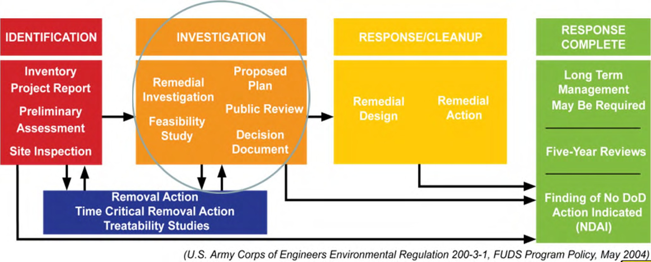
Process Overview for FUDS
Project is currently at this stage
U.S. Army Corps of Engineers, Engineer Regulation 200-3-1, FUDS Program Policy, May 2004

Slide 8
Goals for the Remedial Investigation (RI)
Overall Goal:
  Gather sufficient information to determine the nature and extent of munitions and explosives of concern (MEC) and/or munitions constituents (MC) and assess the potential risks/hazards to evaluate next steps (no further action or remedial action alternative)
Remedial Investigation [RI] Objectives:
  Conduct field investigations to characterize the Munitions Response Site (MRS)
  Determine the type (nature), density, and distribution (extent) of MEC
  Determine the concentrations (if any) and extent of MC
  Assess potential risks/hazards to human health, safety and the environment
  Assess MRS boundaries

Slide 9
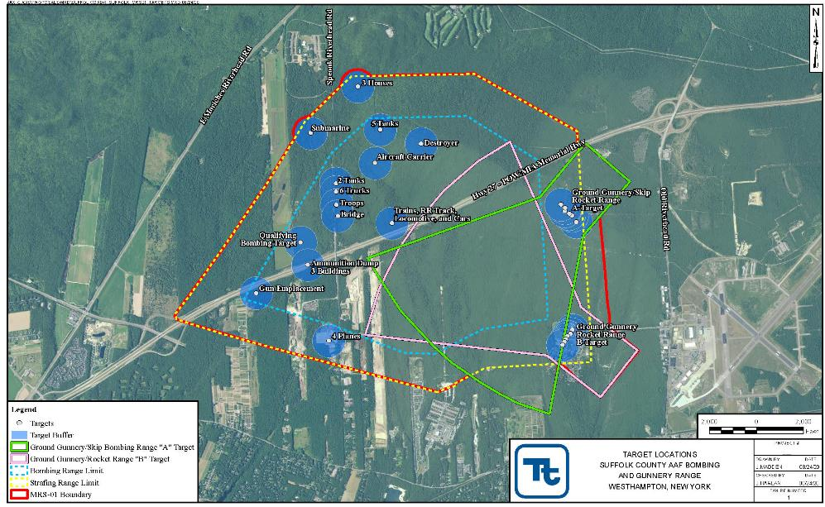
Suffolk County AAF BGR MRS-01
Notes:
Suffolk AAF FUDS – 9,224 acres
Suffolk AAF BGR MRS-01 – 4,297 acres
Site used from 1943-1946 for bombing, strafing, and rocket fire training exercises at 4 sub-ranges
Ground Gunnery/Skip Bombing A
Ground Gunnery/Rocket Range B
Bombing Range
Strafing Range

Slide 10
Suffolk County AAF BGR MRS-01
Site Information
  Majority of the training exercises appear to have been .50 caliber machine guns, practice bombs, and practice rockets
  From May 1943 through January 1944 100-lb and 500-lb high explosive (HE) bombs, incendiary bombs, and 4.5-in HE rockets were reportedly used on the numerous targets located throughout the MRS
  No military structures remain except for two target silhouettes (a destroyer and aircraft carrier)
  Records indicate a surface clearance was conducted in 1946

Slide 11
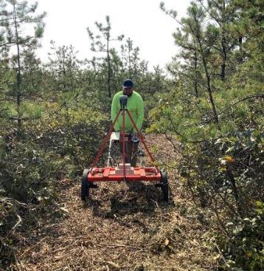
Fieldwork completed to date
Preliminary MRS Characterization (Phase 1)
Transect establishment in non-residential area
  All transects were walked by a biologist to identify any wetlands or T&E species; none were observed
Geophysical data collection with EM61 along transects
Total length of mapped transects was approximately 61 miles or 24 acres
Identified follow up areas for placement of 28 grids approximately 50 feet x 100 feet in size

Slide 12
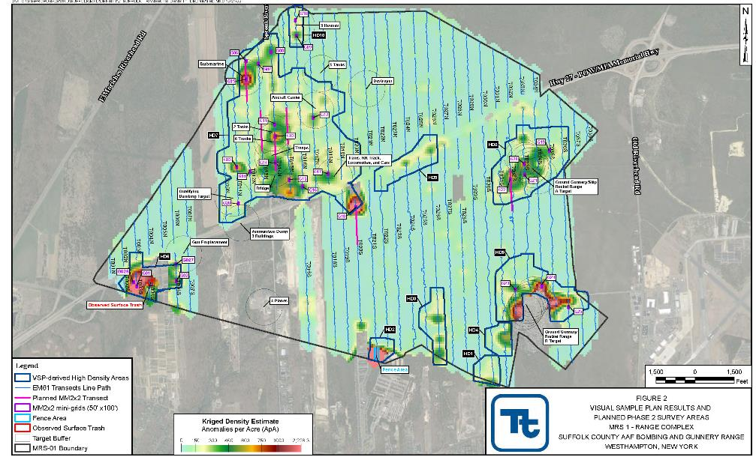
Phase 1 Identified High-Density Areas

Slide 13
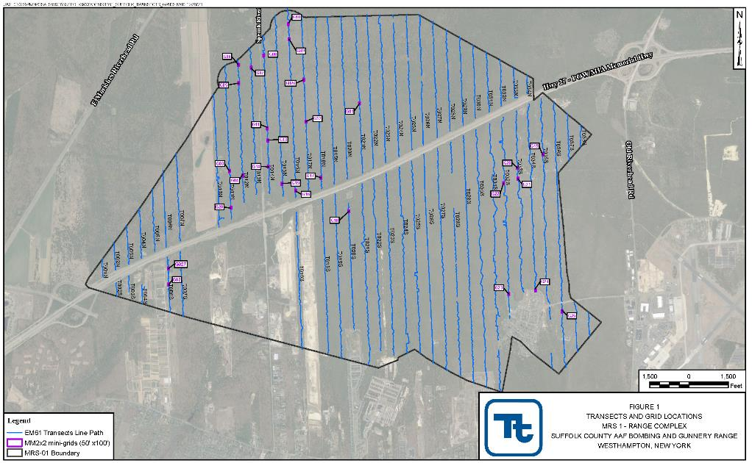
Transect and Grid Locations

Slide 14
Fieldwork completed to date
High Density/Low Density Area Characterization (Phase 2)
Grids were marked and recorded by a licensed land surveyor.
24 grids in residential area
28 grids in non-residential area
Removed all metals from the ground surface, whether DoD related or not, in each grid.
Used MetalMapper 2x2 to collect data within each grid
Determined dig list
No munitions and explosives of concern or munitions debris were found on the surface during field activities.

Slide 15
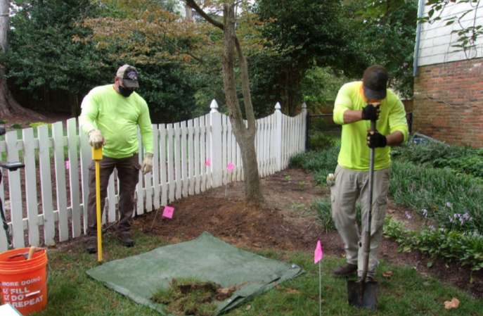
Phase 3 Fieldwork – Intrusive Investigation
Intrusive Investigation
UXO technicians will dig the target locations with hand tools
  When excavating potential munitions, a safety zone of up to 638 feet will be established around the dig area and temporary displacement of residents will be needed.
  For any munition that is found, we will safely detonate it at the existing locations, OR if necessary and it’s safe to move, we will detonate it elsewhere within the MRS project area.

Slide 16
What Does This Mean for Me?
Fieldwork
  Contractors will be conducting the residential portion of digging operations starting April 8th for up to 2 weeks
  Expect between 10-15 personnel for the digging operations, including support staff to coordinate safety zones
The Dig team will only be working at properties where a right of entry was signed AND where geophysical surveys were completed.
USACE is not seeking additional rights of entry at this time.
However, in order to maintain the safety zone during digging operations occupants of nearby houses will be asked to leave their home from 8:30 am – 2:30 pm on certain days
Additional work will be conducted before and after the safety zone is in effect during the hours of 8:00 am – 5:00 pm

Slide 17
What Does This Mean for Me?
Temporary road closures may be in effect but will be limited and marked appropriately.
Letters to affected residents have been mailed and additional mailings will follow.
Temporarily displaced residents will have access to the following:
  Day-Use Hotel Conference Room and Private Rooms @ the Residence Inn Long Island East End, 2012 Old County Road, Riverhead, NY
    Please try to provide USACE 24 hours notice if a private hotel room is needed (available from 7 am – 3 pm)
    Continental breakfast and lunch will be served in the assigned Conference Room
  Lunch food allowance based on General Services Administration (GSA) Rates
    Gift card will be provided upon request

Slide 18
What Does This Mean for Me?
  Transportation to Hotel & Back, if needed
    Please provide 24 hours notice to USACE/Contractor team.
  Pet Kenneling/Day Care
    Pets must be current on all vaccinations (for example, for dogs this includes rabies, kennel cough, parvo, distemper, and Bordetella), be spayed/neutered, and be 6 months of age or older.
  Plan to take anything needed during the day with you when you leave your house, including phone, wallet/purse, medications, etc.
  The field team will monitor all safety zones and stop work if non-essential personnel breach perimeter.

Slide 19
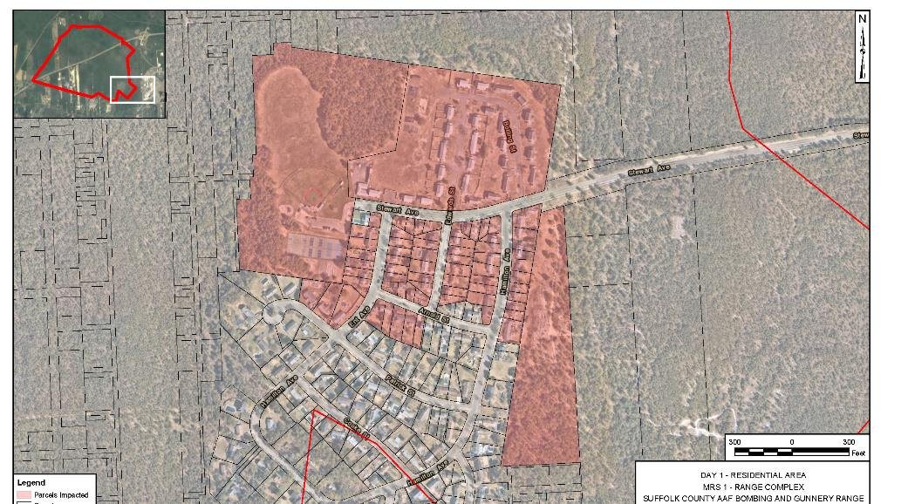
Temporary displacements - day 1

Slide 20
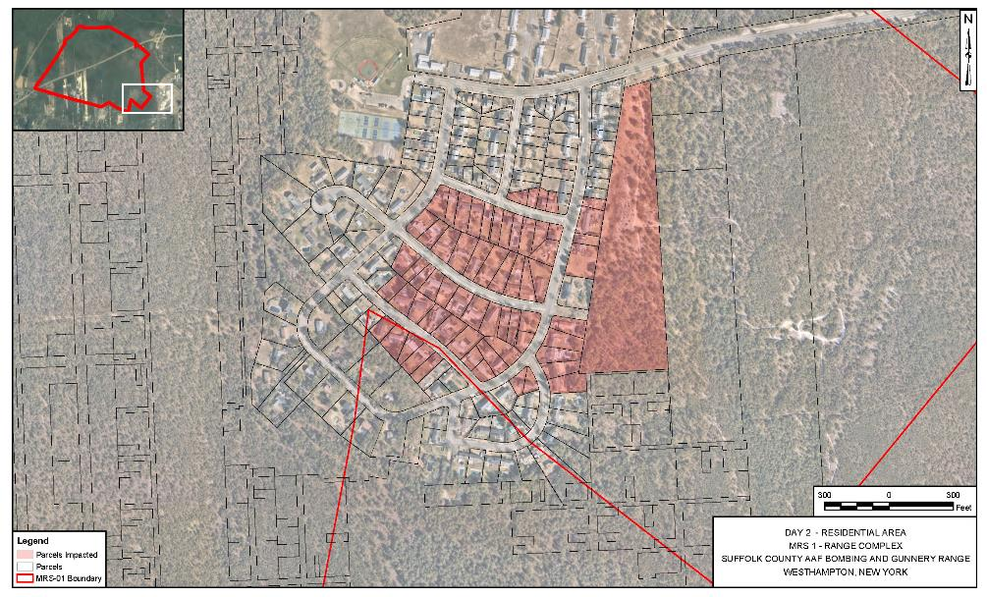
Temporary displacements – day 2

Slide 21
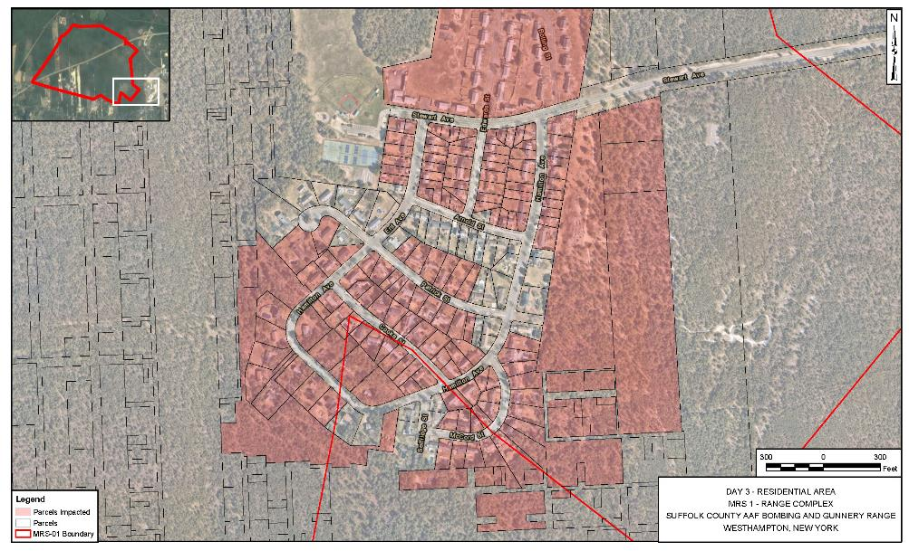
Temporary displacements – day 3

Slide 22
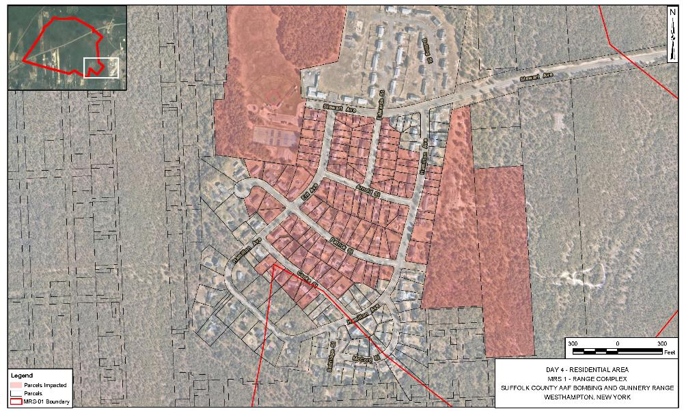
Temporary displacements – day 4

Slide 23
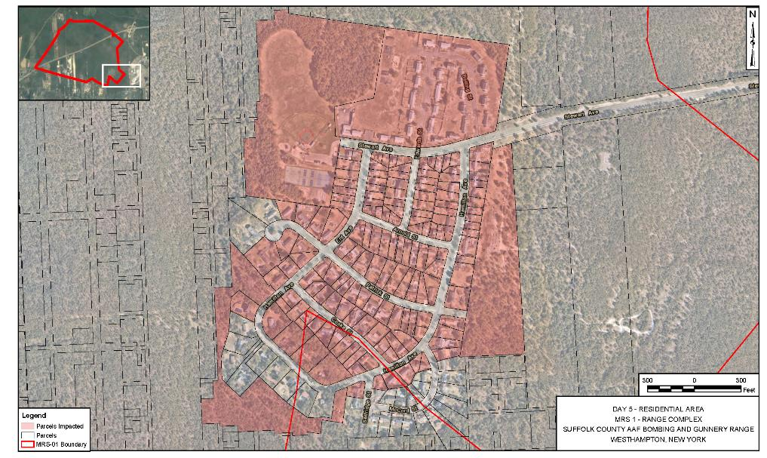
Temporary displacements – day 5

Slide 24
Where to Find Information on the Project
USACE website:
  https://www.nae.usace.army.mil/Missions/Projects-Topics/Suffolk-County-Army-Air-Field-Bombing-and-Gunnery-Range-FUDS/
  Fact Sheets
  Project Documents
  Contact Information
Town of Southampton website: http://www.southamptontownny.gov
Westhampton Free Library
  Project documents will be available for public review, as they are finalized

Slide 25
In-person office hours and meeting
Office Hours: Westhampton Free Library, 7 Library Avenue, Westhampton Beach
  USACE personnel will be available for interested parties to drop by, view project information, and ask questions at the following times:
  Wednesday, March 27th: 4:00 – 6:00 PM
  Thursday, March 28th: 12:00 – 4:00 PM
  Friday, March 29th: 10:15 – 12:00 PM
In-Person Meeting: Westhampton Beach Fire Department, 92 Sunset Ave, Westhampton Beach
  Thursday, March 28th: 7:00 – 8:30
  Presentation at 7:00 pm followed by a Q&A/Discussion period
  Note this is the same presentation being provided at the Virtual Meeting on March 25th

Slide 26
Estimated SCHEDULE: What’s next?
Fieldwork
  Intrusive (digging) operations continue March-April 2024
  Soil Sampling Summer/Fall 2024; locations based on intrusive work
Reports
  RI Report - Summer 2025
  Feasibility Study Report – Winter/Spring 2026
  Proposed Plan – Fall 2026 (includes public meeting)
  Final ROD - Summer/Fall 2027
  Remedial Action (if necessary) – starting in 2029

Slide 27
SAFETY REMINDER
FOLLOW THE 3Rs OF EXPLOSIVES SAFETY:
Recognize:
When you may have encountered a munition and that munitions are dangerous.
Retreat:
Do not approach, touch, move or disturb it, but carefully leave the area.
Report:
Call 911 and advise the police of what you saw and where you saw it.

Slide 28
Questions / Open Discussion
USACE website:
https://www.nae.usace.army.mil/Missions/Projects-Topics/Suffolk-County-Army-Air-Field-Bombing-and-Gunnery-Range-FUDS/

